Slide 1


Market Basket Analysis
Name: Divyanshi Maurya
Section: K22UG
Roll number: RK22UGA33
Reg. no.: 12219959
Final Presentation for CSM 351: EDA Project

Slide 3



Introduction:
In today's competitive online retail market, providing personalized shopping experiences has become essential for businesses to stay relevant and engage customers effectively. One of the most powerful ways to achieve this is through product recommendation systems, which suggest relevant items based on users' behaviors and preferences. My project focuses on building a recommendation system using association rule mining techniques such as Apriori and FP-growth algorithms. These techniques analyze transactional data to discover patterns and relationships between products, helping businesses enhance their sales strategies and improve customer satisfaction.

Slide 4
Why I have choose this project:
I chose this project because personalization has become a key factor in customer satisfaction and business growth in the e-commerce sector. By recommending products that align with customer preferences, businesses can increase customer engagement, boost sales, and enhance overall shopping experiences. I have always been interested in data science and its application to real-world problems, and this project provides an excellent opportunity to explore techniques like association rule mining.
Additionally, the growing amount of transactional data in online retail platforms provides a unique challenge: how to effectively analyze and derive meaningful insights from large datasets. The ability to make accurate, real-time recommendations that truly benefit users motivates me to apply algorithms such as Apriori and FP-growth to generate association rules and provide a personalized shopping experience.
Ultimately, this project will give me hands-on experience in data mining and machine learning, and it will allow me to contribute to the growing field of recommendation systems that have a tangible impact on customer experience.

Slide 5
Abstract
Market Basket Analysis for Product Recommendation System
Objective:
The goal of this project is to build a recommendation system using Apriori Analysis to enhance the shopping experience by recommending related products based on customer purchases. The dataset, sourced from the UCI Machine Learning Repository, contains transaction data from an online retail store, including product descriptions, quantities, and customer information.
Process:
Data Preprocessing: Outliers and irrelevant records were removed, and the dataset was indexed for relevant transactions.
Apriori Algorithm: Applied to generate frequent itemsets using Support, Confidence, and Lift metrics, followed by association rule generation.
FP-Growth Algorithm: Used for efficient mining of frequent itemsets to improve recommendation accuracy.
Recommendation: Recommending frequent itemsets using above algorithms

Slide 6
Frequently purchased product pairs were identified, revealing strong relationships among items, which can be used for cross-selling and increasing customer activity.
The system allows users to input a product name and retrieve related product recommendations based on the generated association rules.
Insights:
Future Work:
Expanding the dataset and exploring hybrid recommendation techniques to improve precision and applicability.
Impact:
This project provides valuable insights for developing product recommendation systems, enriching customer experience, and optimizing sales strategies.

Slide 7
Problem Statement:
The problem I aim to solve with this project is the lack of personalized product recommendations in online retail platforms. Customers often struggle to find products that match their interests, leading to a less engaging shopping experience. By using association rule mining techniques, such as the Apriori and FP-growth algorithms, I want to identify patterns in customer purchase behavior to recommend related products. The challenge is to efficiently process large transaction datasets, generate accurate recommendations, and provide a user-friendly, personalized shopping experience. My goal is to create a system that helps customers discover relevant products based on their past behavior, improving both customer satisfaction and business sales.

Slide 8
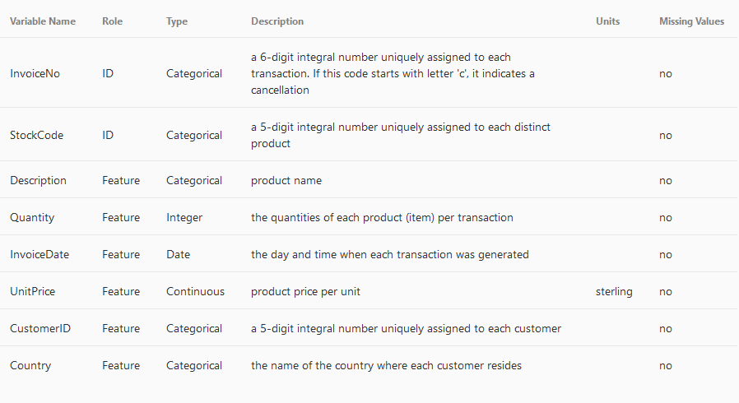
Dataset description:
It is a transacational data set which contains all the transactions occurring between 01/12/2010 and 09/12/2011 for a UK-based and registered non-store online retail.

Slide 9
What is EDA?
EDA is the process of analyzing and visualizing a dataset to summarize its main characteristics, often with the help of graphical representations. It helps us to understand the structure, patterns, and relationships in the data before applying any machine learning models.
Key Steps in EDA:
Data Collection: Gather data from various sources.
Data Cleaning: Handle missing values, errors, and outliers.
Data Visualization: Use charts (like histograms, scatter plots) to spot trends and patterns.
Statistical Summary: Look at basic statistics (mean, median, standard deviation) to understand the data's central tendency and spread.
Feature Engineering: Create new variables or modify existing ones to improve analysis.
Goal: The goal of EDA is to explore the dataset thoroughly, find hidden insights, and prepare the data for further analysis or modeling.

Slide 10
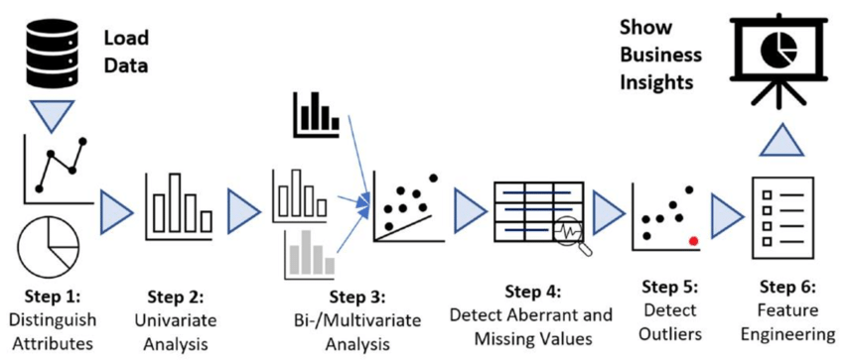

Slide 11
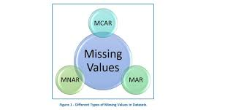
What is Missing Values?
Missing values occur when some data points are absent in a dataset, which can lead to inaccurate analysis or model performance. Handling missing values is crucial to ensure data integrity. Common strategies include removal, where rows or columns with missing data are deleted, and imputation, where missing values are replaced with estimates, such as the mean, median, or mode for numerical data, or the most frequent category for categorical data. Another approach is using predictive models to estimate missing values based on existing data. The choice of technique depends on the nature of the data and the extent of missing values. Handling missing values effectively ensures that the analysis remains robust and reliable.

Slide 12
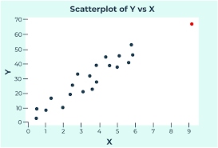
What is Outliers?
Outliers are data points that significantly differ from the majority of the data in a dataset. They are values that fall far outside the expected range and can distort statistical analyses and models. Outliers can be caused by errors in data collection, measurement, or represent rare but valid occurrences. Identifying and handling outliers is important because they can skew the results, affecting measures like mean and standard deviation. Common methods for detecting outliers include visualizations like box plots and scatter plots, and statistical methods like the z-score or IQR (Interquartile Range). Once identified, outliers can be handled by removal, transformation, or imputation, depending on whether they are errors or genuine extreme values.

Slide 13
What is Univariate analysis?
Univariate Analysis is the simplest form of data analysis that focuses on analyzing a single variable at a time. It involves examining the distribution, central tendency (mean, median, mode), and dispersion (variance, standard deviation) of the variable. This analysis helps in understanding the individual behavior of the data and identifying patterns, trends, or outliers in that specific variable. Common techniques used in univariate analysis include histograms, box plots, and bar charts, which visually represent the data’s distribution. It also includes statistical measures like the mean, median, mode, and range to summarize the central value and spread of the variable. Univariate analysis is often the first step in exploring a dataset, as it gives insights into individual variables and sets the stage for more complex multivariate analysis. This type of analysis is useful for detecting anomalies, verifying data quality, and preparing the data for further analysis.

Slide 14
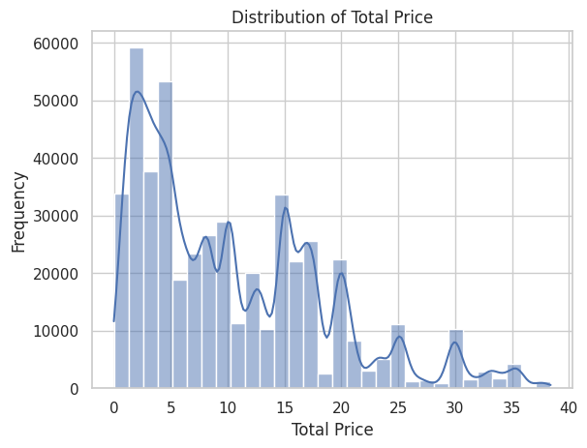
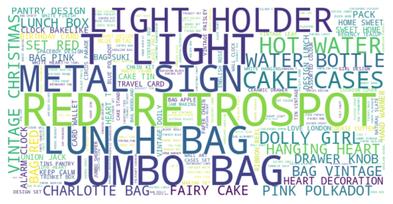
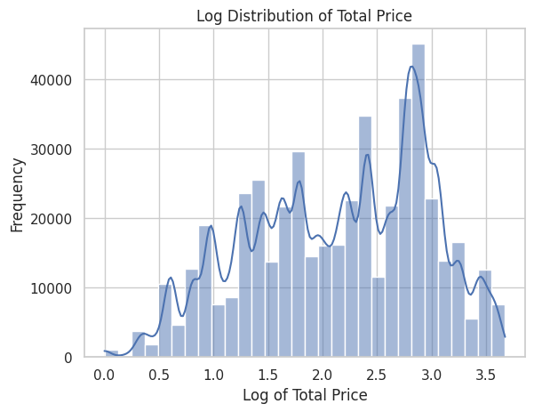
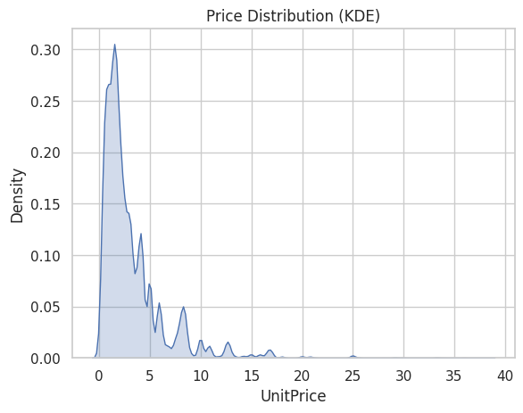
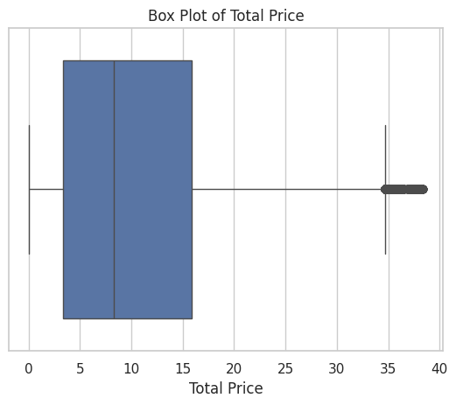

Slide 15
What is Bivariate analysis?
Bivariate Analysis involves the analysis of two variables simultaneously to determine the relationship between them. It helps in understanding how one variable affects or is related to another. The goal is to examine correlations, patterns, and associations between the two variables. Common methods of bivariate analysis include scatter plots, correlation coefficients, and cross-tabulation (contingency tables). For numerical variables, a scatter plot is often used to visualize the relationship, while Pearson's correlation coefficient measures the strength and direction of the relationship. For categorical variables, cross-tabulation can reveal how different categories interact. Bivariate analysis is essential for identifying dependencies, testing hypotheses, and exploring potential causal relationships between variables, making it a crucial step before moving on to more complex multivariate analysis.

Slide 16
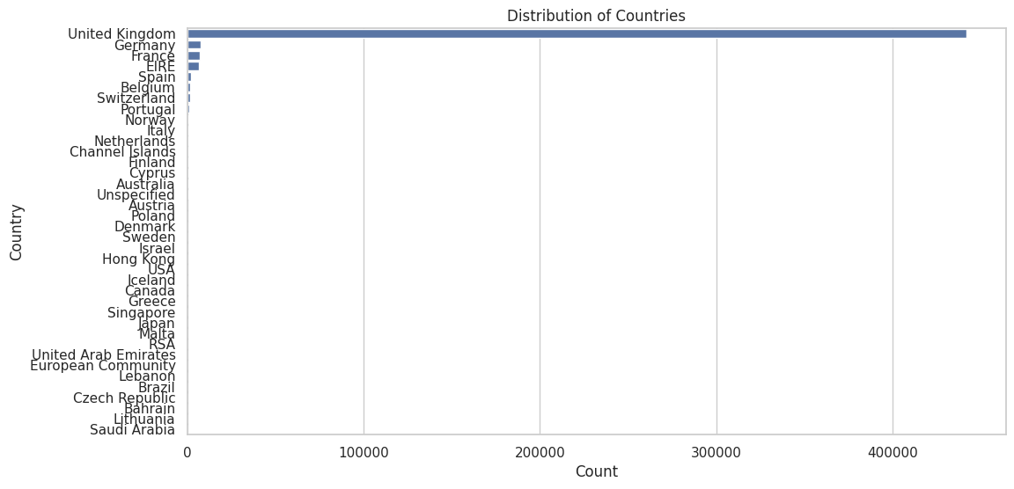
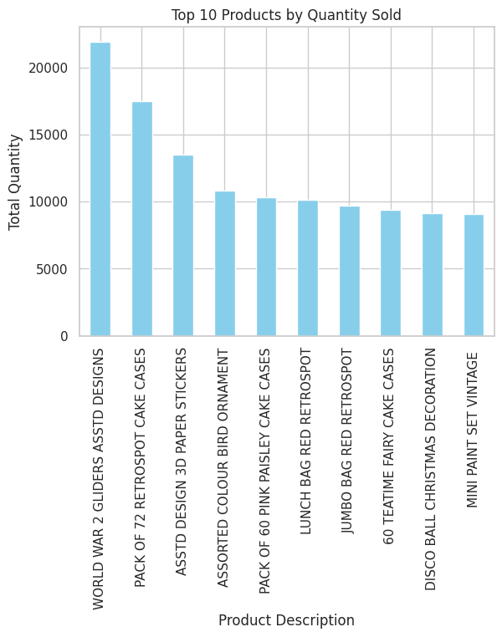
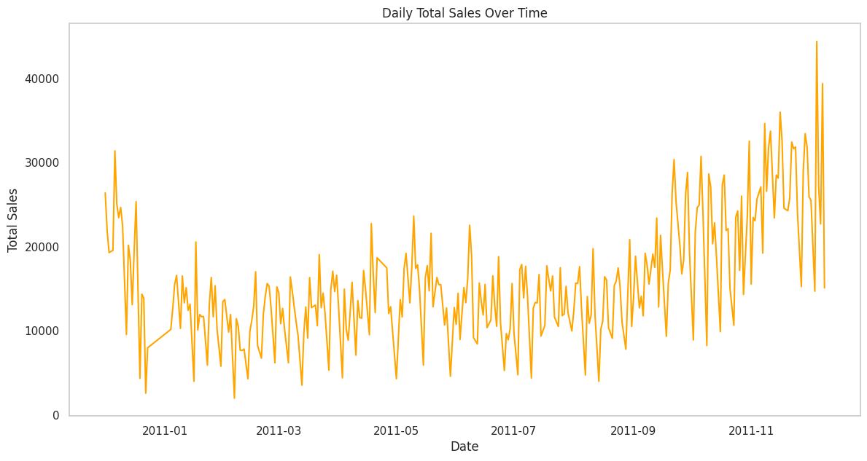

Slide 17
What is Multivariate analysis?
Multivariate Analysis is a statistical technique used to analyze the relationship between three or more variables simultaneously. It helps in understanding how multiple factors interact with each other and affect the outcome. This type of analysis is useful for exploring complex data sets where variables may influence each other in various ways. Common methods of multivariate analysis include Multiple Regression, Principal Component Analysis (PCA), Factor Analysis, and Cluster Analysis. Multiple regression examines the relationship between one dependent variable and several independent variables, while PCA reduces the dimensionality of large data sets by transforming variables into a smaller set of uncorrelated components. Factor analysis identifies underlying factors that explain the patterns in the data, and cluster analysis groups data points into clusters with similar characteristics. Multivariate analysis allows for a deeper understanding of complex relationships, helping to uncover patterns and make predictions in data with multiple interacting variables.

Slide 18
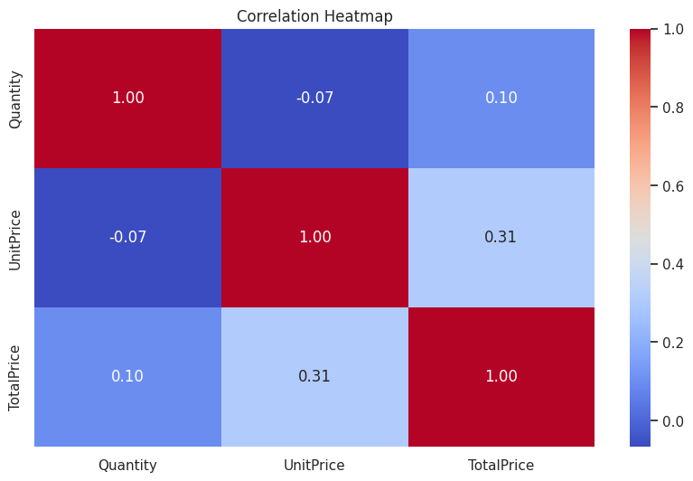
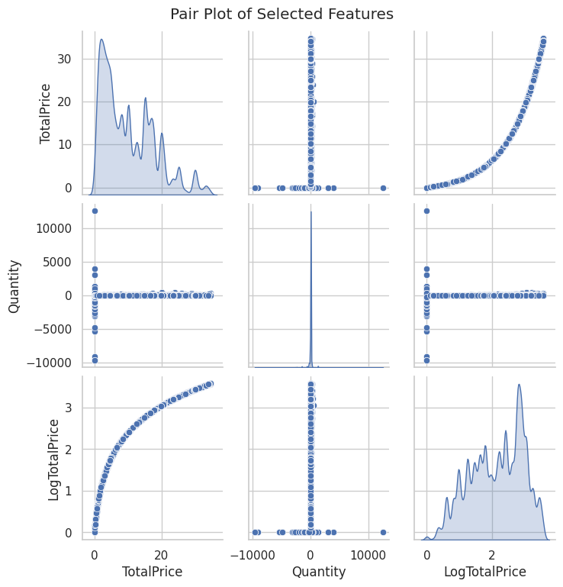
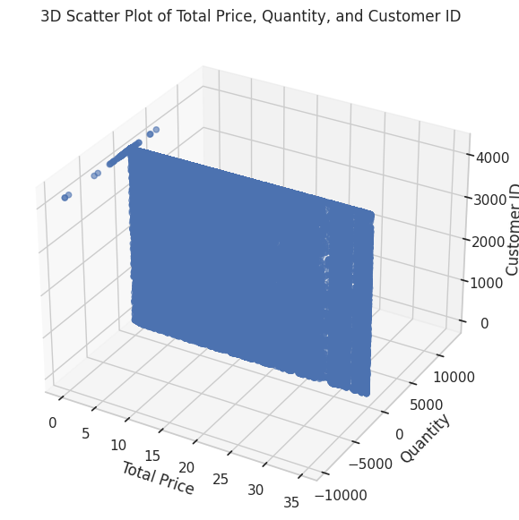

Slide 19
What is Market Basket Analysis?
Market Basket Analysis is a data mining technique used to find relationships or associations between products that are frequently bought together by customers.
Key Concepts:
Itemsets: Groups of products purchased together.
Frequent Itemsets: Itemsets that appear frequently in transactions.
Association Rules: Rules that show how the purchase of one item leads to the purchase of another (e.g., "If a customer buys bread, they are likely to buy butter").
Key Metrics:
Support: How frequently an itemset appears in transactions.
Confidence: Likelihood that item Y is bought when item X is bought.
Lift: Measures how much more likely two items are bought together than individually.

Slide 20
Aspect | Exploratory Data Analysis (EDA) | Market Basket Analysis
Purpose | To summarize and understand the main characteristics of the dataset. | To uncover relationships between products purchased together.
Focus | General insights into data distributions, patterns, and anomalies. | Identifying frequent itemsets and association rules in transactions.
Techniques Used | Statistical summaries, visualizations (histograms, boxplots), and correlations. | Association rule mining using algorithms like Apriori and FP-growth.
Data Type | Primarily numerical or categorical data for general analysis. | Transactional data with product-item relationships.
Goal | To clean, preprocess, and understand data before further analysis. | To provide product recommendations based on customer purchases.
Outcome | Insights into the dataset's structure, outliers, and trends. | Rules for product recommendations (e.g., if A, then B).
Tools/Methods | Visual tools like histograms, boxplots, and heatmaps. | Algorithmic methods like Apriori, FP-growth for pattern detection.
Use Case | Used at the initial stages of data analysis for exploration. | Used in retail and e-commerce for product recommendation.

Slide 21
What is Frequent itemsets?
A frequent itemset is a set of items that appear together in a dataset more often than a predefined threshold or support value. In the context of Market Basket Analysis, it refers to combinations of products that are frequently purchased together by customers. The frequency of an itemset is determined by the support, which is the proportion of transactions that contain the itemset.
For example, if in 100 transactions, the itemset {Milk, Bread} appears in 30 transactions, the support for {Milk, Bread} is 30%. If the minimum support threshold is set to 20%, {Milk, Bread} would be considered a frequent itemset.
Identifying frequent itemsets is the first step in association rule mining and helps in discovering relationships between products, such as products that are commonly bought together. These relationships are later used to generate association rules for recommendations, like "if a customer buys Milk, they are likely to buy Bread as well."

Slide 22
What is Apriori Property?
The Apriori Property is a fundamental concept in the Apriori algorithm used for Market Basket Analysis. It states that:
"If an itemset is frequent, then all of its subsets must also be frequent."
In simpler terms, if a combination of items (called an itemset) appears frequently in a dataset (based on a minimum support threshold), then any smaller combination (subset) of those items must also appear frequently. This property helps in reducing the number of itemsets to check during the algorithm’s execution, making the process more efficient.
Example:
If the itemset {A, B, C} is frequent (appears in a sufficient number of transactions), then the subsets {A, B}, {A, C}, and {B, C} must also be frequent.
If {A, B, C} is not frequent, the subsets {A, B}, {A, C}, and {B, C} will also be removed from consideration, saving time in the analysis.
This property allows the algorithm to prune or eliminate unlikely itemsets early, reducing the computational complexity and focusing only on itemsets that have the potential to be frequent.

Slide 23
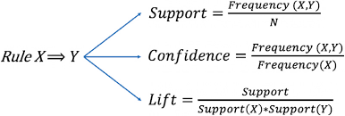
What is Support, Lift and Confidence?

Slide 24
Apriori Algorithm
Let us consider a small transactional dataset with 5 transactions:
Transaction ID | Items Purchased
T1 | {Bread, Milk}
T2 | {Bread, Diaper, Beer}
T3 | {Milk, Diaper, Beer}
T4 | {Bread, Milk, Diaper}
T5 | {Bread, Milk, Beer}
Step 1: Calculate Support for Individual Items (1-itemsets)
First, count the frequency of each individual item:
Item Frequency Support (%)
Bread 4 4/5 = 0.80
Milk 4 4/5 = 0.80
Diaper 3 3/5 = 0.60
Beer 3 3/5 = 0.60
Minimum support threshold = 0.60 (60%)
Thus, the frequent 1-itemsets (those with support ≥ 0.60) are:
Bread (0.80), Milk (0.80), Diaper (0.60), Beer (0.60)

Slide 25
Step 2: Calculate Support for 2-itemsets (Pairs)
Now, we generate 2-itemsets and count how many transactions contain each pair:
Itemset | Frequency | Support (%)
{Bread, Milk} | 3 | 3/5 = 0.60
{Bread, Diaper} | 2 | 2/5 = 0.40
{Bread, Beer} | 2 | 2/5 = 0.40
{Milk, Diaper} | 2 | 2/5 = 0.40
{Milk, Beer} | 3 | 3/5 = 0.60
{Diaper, Beer} | 2 | 2/5 = 0.40
Frequent 2-itemsets (support ≥ 0.60):
{Bread, Milk} (0.60)
{Milk, Beer} (0.60)
Step 3: Prune Non-Frequent Itemsets
Remove the itemsets with support less than the minimum support threshold (60%).
Itemset | Frequency | Support (%)
{Bread, Milk} | 3 | 0.60
{Milk, Beer} | 3 | 0.60
Thus, only {Bread, Milk} and {Milk, Beer} remain as frequent 2-itemsets.

Slide 26
Step 4: Generate 3-itemsets (Combinations of 3 Items)
Now, we combine the frequent 2-itemsets to form 3-itemsets and count their occurrences.
Itemset | Frequency | Support (%)
{Bread, Milk, Beer} | 2 | 2/5 = 0.40
Since {Bread, Milk, Beer} has a support of 40%, which is below the minimum threshold of 60%, it is not considered frequent.
Conclusion:
From the above steps, we identify the frequent itemsets as:
Frequent 1-itemsets: Bread, Milk, Diaper, Beer
Frequent 2-itemsets: {Bread, Milk}, {Milk, Beer}
The Apriori algorithm stops here because no frequent 3-itemsets were found.
These frequent itemsets can then be used to generate association rules like:
{Bread} → {Milk} (If a customer buys Bread, they are likely to buy Milk).
{Milk} → {Beer} (If a customer buys Milk, they are likely to buy Beer).

Slide 27
What is Trie Data Structure?
A Trie is a tree-like data structure used to efficiently store and search a collection of strings, such as a dictionary or a set of words. Each node in a Trie represents a character, and the edges between nodes represent transitions between characters. The key advantage of a Trie is its ability to perform fast search operations based on the characters of the strings, especially useful in applications like autocomplete and spell checking.
In a Trie, common prefixes are shared among words, making it more memory-efficient than other data structures for storing strings with common parts. The Trie supports operations such as insertion, searching, and prefix matching in time complexity proportional to the length of the word, making it very efficient for these tasks.
For example, in a Trie storing words like "cat", "cap", and "bat", the structure will share common prefixes like "c" and "a" to save space and time. Although a Trie can be more space-consuming than other structures like hash tables, it provides quick lookups and is especially useful in applications that need to find words or prefixes quickly.

Slide 28
Frequent Pattern Growth Algorithm:
The FP-Growth algorithm uses the following steps to find frequent itemsets:
Construct the FP-tree:
The algorithm first scans the dataset to find the frequent 1-itemsets.
It then constructs the FP-tree by inserting transactions into the tree, maintaining item order based on frequency (most frequent items are placed first).
Mining the FP-tree:
Starting from the frequent 1-itemsets, FP-Growth recursively mines the tree to find larger frequent itemsets.
It uses a divide-and-conquer approach to recursively mine the tree and find itemsets that meet the support threshold.

Slide 29
Consider a transaction dataset:
Transaction ID | Items
T1 | {Bread, Butter, Jam}
T2 | {Bread, Butter}
T3 | {Bread, Jam}
T4 | {Butter, Jam}
T5 | {Bread, Butter, Jam}
Step 1: Calculate Support for Each Item
Support(Bread) = 4/5 = 0.8
Support(Butter) = 4/5 = 0.8
Support(Jam) = 3/5 = 0.6
Step 2: Create the FP-tree
The tree will be constructed by adding transactions in the following order, based on frequency:
Bread → Butter → Jam (T1)
Bread → Butter (T2)
Bread → Jam (T3)
Butter → Jam (T4)
Bread → Butter → Jam (T5)

Slide 30
Step 3: Mine the FP-tree
Find frequent itemsets from the FP-tree:
{"Bread", "Butter"} with support 4/5
{"Bread", "Jam"} with support 3/5
{"Butter", "Jam"} with support 3/5
Step 4: Generate Association Rules
Generate association rules using confidence and lift:
For rule {"Bread" → "Butter"}, calculate:
Confidence = Support(Bread, Butter) / Support(Bread) = 4/5 / 4/5 = 1.0
Lift = Confidence / Support(Butter) = 1.0 / 0.8 = 1.25
Similarly, calculate for other possible rules.

Slide 31
Result and Analysis:
Time Complexity of Apriori Algorithm:
O(T × C_k × n)
T = Number of transactions.
C_k = Number of candidate itemsets of size kkk.
n = Number of items in the dataset.
Apriori requires multiple iterations over the dataset, and at each iteration, it generates candidate itemsets and scans the transactions to check their support.
This results in a high time complexity, especially with large datasets.
Space Complexity of Apriori Algorithm:
O(C_k + F_k)
C_k = Number of candidate itemsets.
F_k = Number of frequent itemsets.
Memory is used to store candidate itemsets and frequent itemsets. As the dataset grows, so does the space required to store these sets.

Slide 32
Time Complexity of FP Growth:
O(T × N + k)
T = Number of transactions.
N = Number of distinct items.
k = Number of frequent itemsets.
FP-growth constructs the FP-tree in two passes over the dataset and then mines the frequent itemsets. This makes it more efficient than Apriori, especially with large datasets.
Space Complexity of FP Growth:
O(T × N + F_k)
T = Number of transactions.
N = Number of distinct items.
F_k = Number of frequent itemsets.
The space used is for storing the FP-tree structure and frequent itemsets. However, FP-growth’s compact tree structure results in lower memory usage than Apriori.

Slide 33
Comparison:
Apriori: Higher time and space complexity due to candidate generation and multiple iterations.
FP-growth: More efficient in both time and space due to its FP-tree structure and reduced candidate generation.
Conclusion:
FP-growth is more scalable and efficient, especially for large datasets, compared to Apriori.
Algorithm | Time Complexity | Space Complexity
Apriori | O(T×Ck×n) | O(Ck+Fk)
FP-growth | O(T×N+k) | O(T×N+Fk)

Slide 34

Getting Recommendation:
product_to_recommend = 'LUNCH BAG RED RETROSPOT'

Slide 35
Conclusion:
In conclusion, both Apriori and FP-growth algorithms are powerful techniques used for association rule mining, but they differ significantly in terms of efficiency and scalability. The Apriori algorithm works by generating candidate itemsets and scanning the entire dataset multiple times, which can lead to high time and space complexities, particularly when dealing with large datasets. Its performance may degrade as the size of the dataset increases, making it less suitable for handling massive transaction databases. On the other hand, the FP-growth algorithm is more efficient. It constructs a compact tree structure, the FP-tree, which allows it to mine frequent itemsets without generating candidate itemsets. This results in faster computation and lower memory usage, especially for large datasets. FP-growth reduces the number of passes over the data, making it more scalable and efficient compared to Apriori. Overall, FP-growth is generally the preferred choice for large-scale data mining tasks due to its better performance in terms of both time and space complexity. However, Apriori can still be useful for smaller datasets or when the dataset has a limited number of frequent itemsets. The choice of algorithm depends on the size and nature of the dataset, as well as the computational resources available.

Slide 36


